Slide 1
Projekt aplikacji do rozpoczęcia inwestowania na giełdzie Prezentacja Podsumowująca
Kamila Białoskórska Adam Bień Patryk Słomian

Slide 2
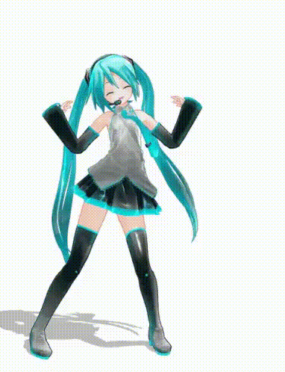
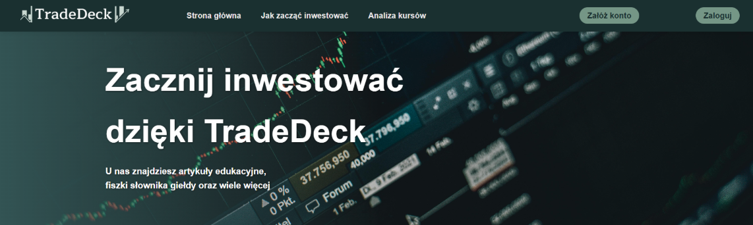
Header - Główna strona
Kamila

Slide 3
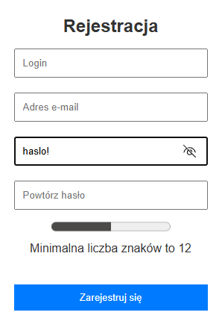
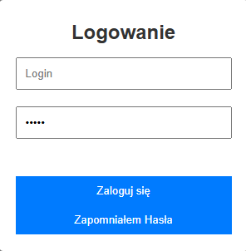
Logowanie i rejestracja
Patryk

Slide 4
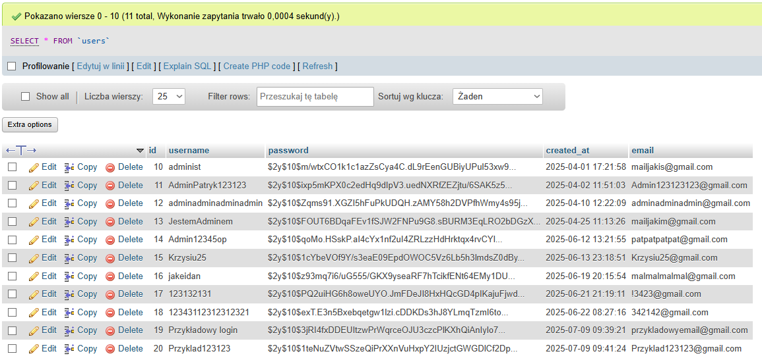
Baza danych - Users
Patryk

Slide 5
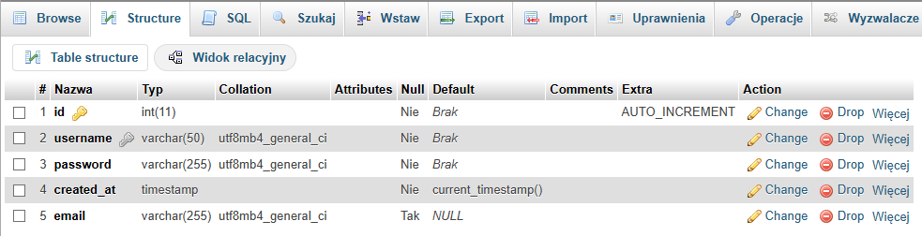
Baza danych - Users
Patryk

Slide 6
Skrypty:
<?php
$host = 'localhost';
$db = 'stock_exchange_rate';
$user = 'root';
$pass = '';
$charset = 'utf8mb4';
$dsn = "mysql:host=$host;dbname=$db;charset=$charset";
$options = [
PDO::ATTR_ERRMODE => PDO::ERRMODE_EXCEPTION,
PDO::ATTR_DEFAULT_FETCH_MODE => PDO::FETCH_ASSOC,
PDO::ATTR_EMULATE_PREPARES => false,
];
try {
$pdo = new PDO($dsn, $user, $pass, $options);
} catch (\PDOException $e) {
throw new \PDOException($e->getMessage(), (int)$e->getCode());
}
?>
Skrypt konfiguracyjny Bazy danych
Patryk

Slide 7
Skrypty:
<?php
session_start();
require 'config_users.php';
if ($_SERVER['REQUEST_METHOD'] == 'POST') {
$username = trim($_POST['username']);
$password = ($_POST['password']);
try {
$stmt = $pdo->prepare('SELECT * FROM users WHERE username = :username');
$stmt->execute(['username' => $username]);
$user = $stmt->fetch(PDO::FETCH_ASSOC);
if ($user && password_verify($password, $user['password'])) {
$_SESSION['loggedin'] = true;
$_SESSION['username'] = $user['username'];
header('Location: index.php');
exit();
} else {
header('Location: index.php?login_error=invalid');
exit();
}
} catch (PDOException $e) {
header('Location: index.php?login_error=server');
exit();
}
} else {
header('Location: index.php?login_error=invalid_request');
exit();
}
?>
Logowanie
Patryk

Slide 8
Skrypty:
<?php
session_start();
require 'config_users.php';
if (isset($_POST['username'], $_POST['email'], $_POST['password'], $_POST['password_confirm'])) {
$username = trim($_POST['username']);
$email = trim($_POST['email']);
$password = ($_POST['password']);
$passwordConfirm =($_POST['password_confirm']);
if (empty($username) || empty($email) || empty($password)) {
header('Location: index.php?register_error=empty');
exit();
}
if (!filter_var($email, FILTER_VALIDATE_EMAIL)) {
header('Location: index.php?register_error=invalid_email');
exit();
}
if (!preg_match('/^[A-Za-z0-9!@#$%^&* \s]{12,128}$/u', $password)) {
header('Location: index.php?register_error=weak_password');
exit();
}
if ($password !== $passwordConfirm) {
header('Location: index.php?register_error=password_mismatch');
exit();
}
Rejestracja
1/2
Patryk

Slide 9
Skrypty:
// Sprawdzenie czy istnieje
try {
$stmt = $pdo->prepare('SELECT * FROM users WHERE username = :username OR email = :email');
$stmt->execute(['username' => $username, 'email' => $email]);
$user = $stmt->fetch();
if ($user) {
header('Location: index.php?register_error=user_or_email_exists');
exit();
}
// Hashowanie
$hashedPassword = password_hash($password, PASSWORD_DEFAULT);
$stmt = $pdo->prepare('INSERT INTO users (username, email, password) VALUES (:username, :email, :password)');
$stmt->execute([
'username' => $username,
'email' => $email,
'password' => $hashedPassword
]);
echo "Rejestracja zakończona sukcesem!";
$_SESSION['loggedin'] = true;
$_SESSION['username'] = $username;
header('Location: index.php');
Rejestracja 2/2
Patryk

Slide 10
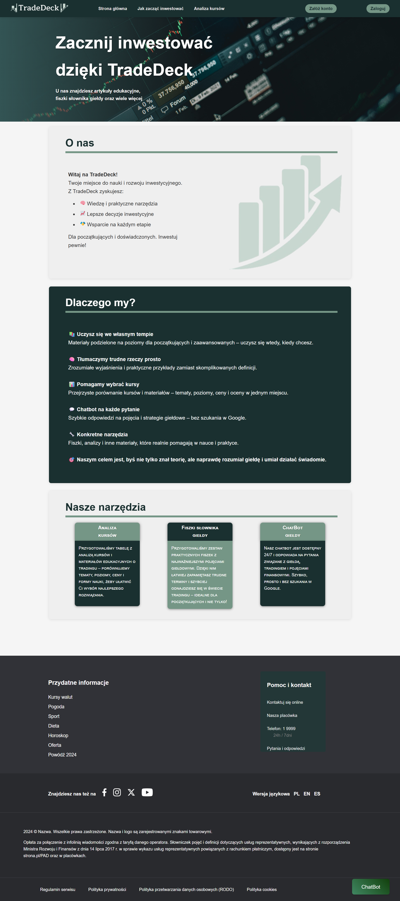
Strona główna
Patryk (backend)
Adam (backend) Kamila (frontend)

Slide 11
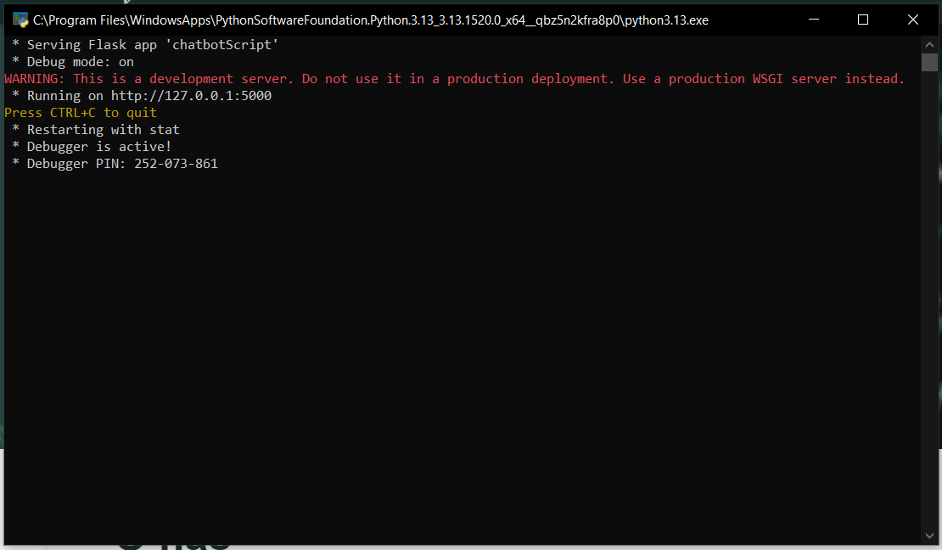
Chatbot API (Flask)
Adam

Slide 12
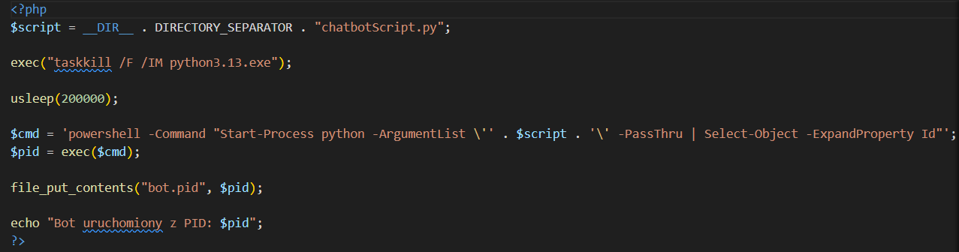
Skrypt uruchamiający API (Flask)
Adam

Slide 13
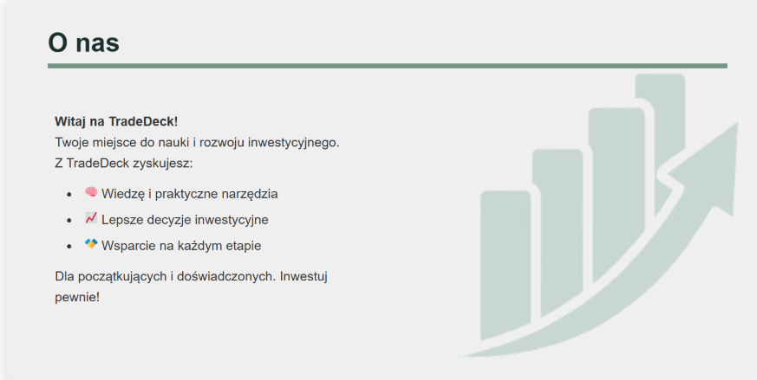
Kamila

Slide 14
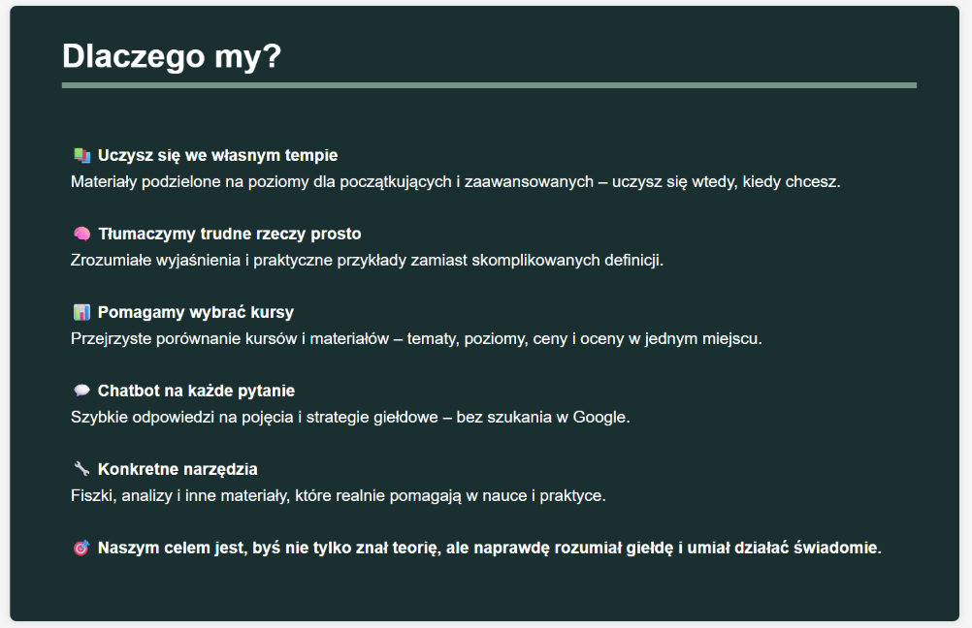
To jest do edycji kamy!!!!
Kamila

Slide 15
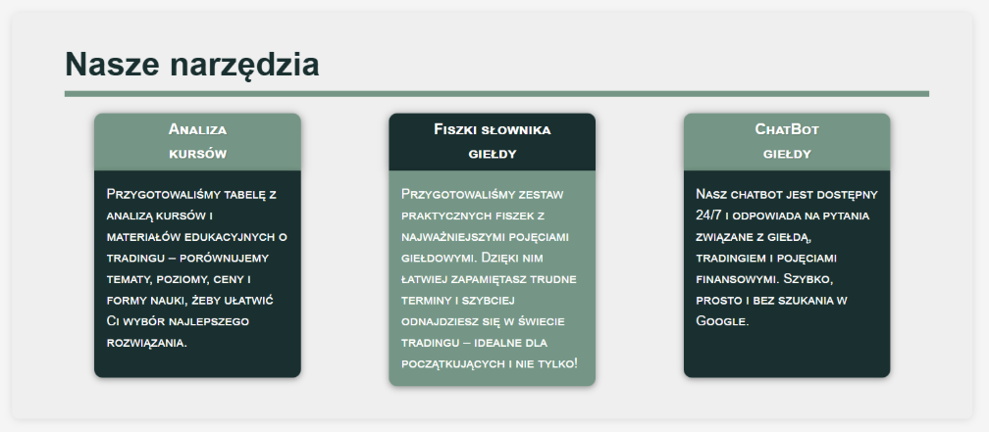
Adam
Kamila

Slide 16
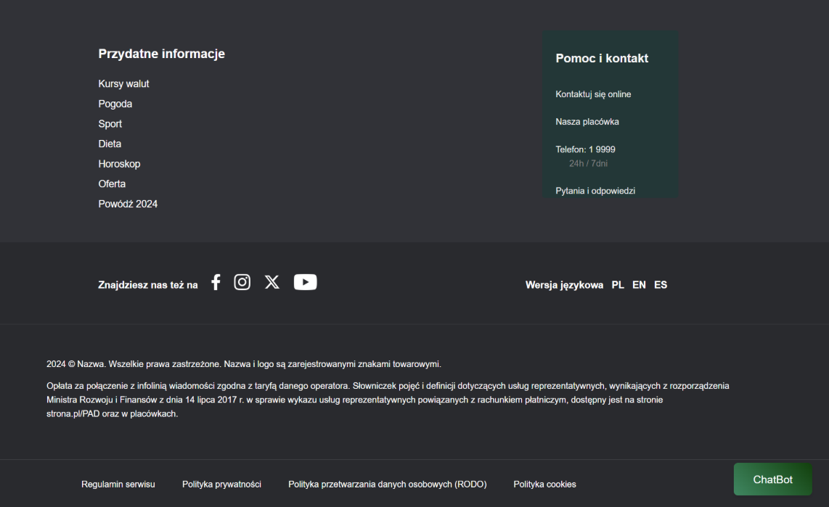
Footer
Patryk

Slide 17
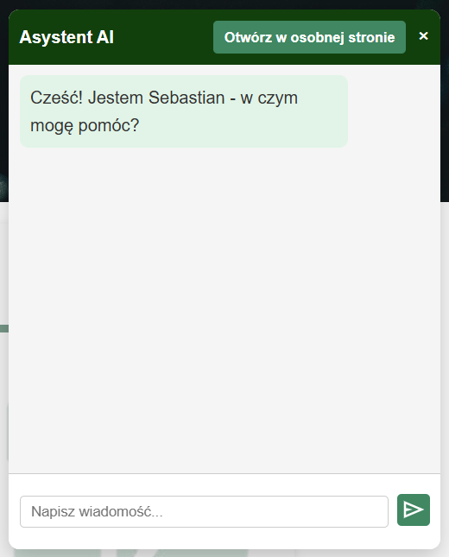
Chatbot Pop-up
Adam

Slide 18
Skrypty:
document.addEventListener('DOMContentLoaded', () => {
const chatbotButton = document.querySelector('.chatbot-button');
const chatbotPopup = document.getElementById('chatbotPopup');
const closeBtn = document.getElementById('closeChatbot');
const sendBtn = document.getElementById('sendMessage');
const userInput = document.getElementById('userInput');
const chatMessages = document.querySelector('.chatbot-body');
chatbotButton.addEventListener('click', () => {
chatbotButton.style.display = 'none';
chatbotPopup.style.display = 'flex';
void chatbotPopup.offsetWidth;
chatbotPopup.classList.add('active');
});
closeBtn.addEventListener('click', () => {
chatbotPopup.classList.remove('active');
setTimeout(() => {
chatbotPopup.style.display = 'none';
chatbotButton.style.display = 'block';
}, 300);
});
sendBtn.addEventListener('click', sendMessage);
userInput.addEventListener('keypress', function(e) {
if (e.key === 'Enter') sendMessage();
});
function appendMessage(text, sender) {
const msgDiv = document.createElement('div');
msgDiv.className = `chat-message ${sender}`;
msgDiv.innerText = text;
chatMessages.appendChild(msgDiv);
chatMessages.scrollTop = chatMessages.scrollHeight;
}
Obsługa rozmowy w Pop-up'ie 1/2
Adam

Slide 19
Skrypty:
function sendMessage() {
const message = userInput.value.trim();
if (!message) return;
appendMessage(message, 'user');
userInput.value = '';
fetch('http://localhost:5000/chat', {
method: 'POST',
headers: {
'Content-Type': 'application/json'
},
body: JSON.stringify({ message })
})
.then(response => {
if (!response.ok) {
throw new Error("Błąd odpowiedzi serwera.");
}
return response.json();
})
.then(data => {
if (data.reply) {
appendMessage(data.reply, 'bot');
} else if (data.error) {
appendMessage("Błąd serwera: " + data.error, 'bot');
}
})
.catch(err => {
console.error("Błąd fetch:", err);
appendMessage("Błąd połączenia z serwerem.", 'bot');
});
}
});
Obsługa rozmowy w Pop-up'ie 2/2
Adam

Slide 20
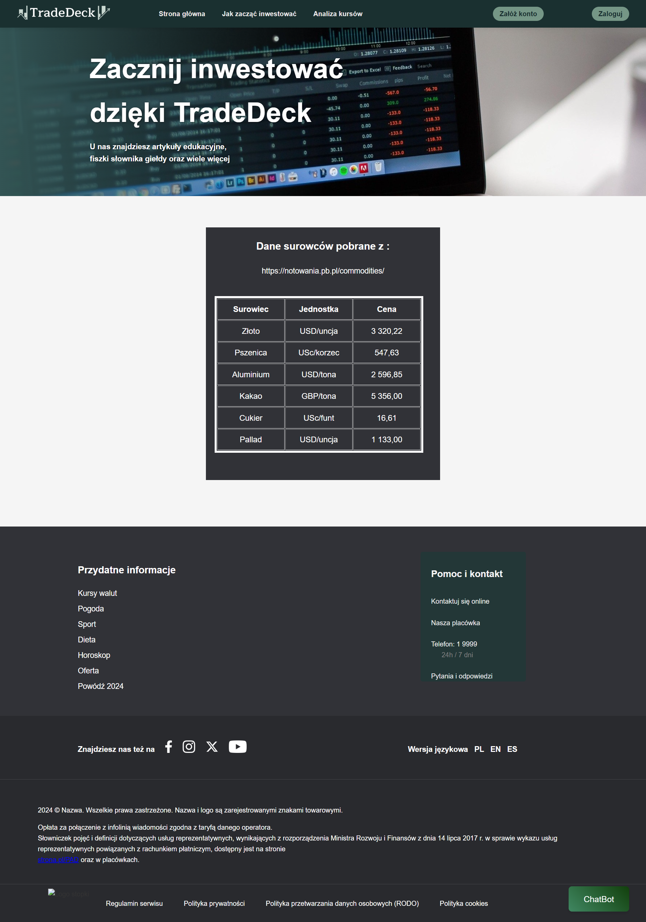
Podstrona z analizą kursów
Patryk (backend + frontend tabeli) Kamila (frontend)

Slide 21
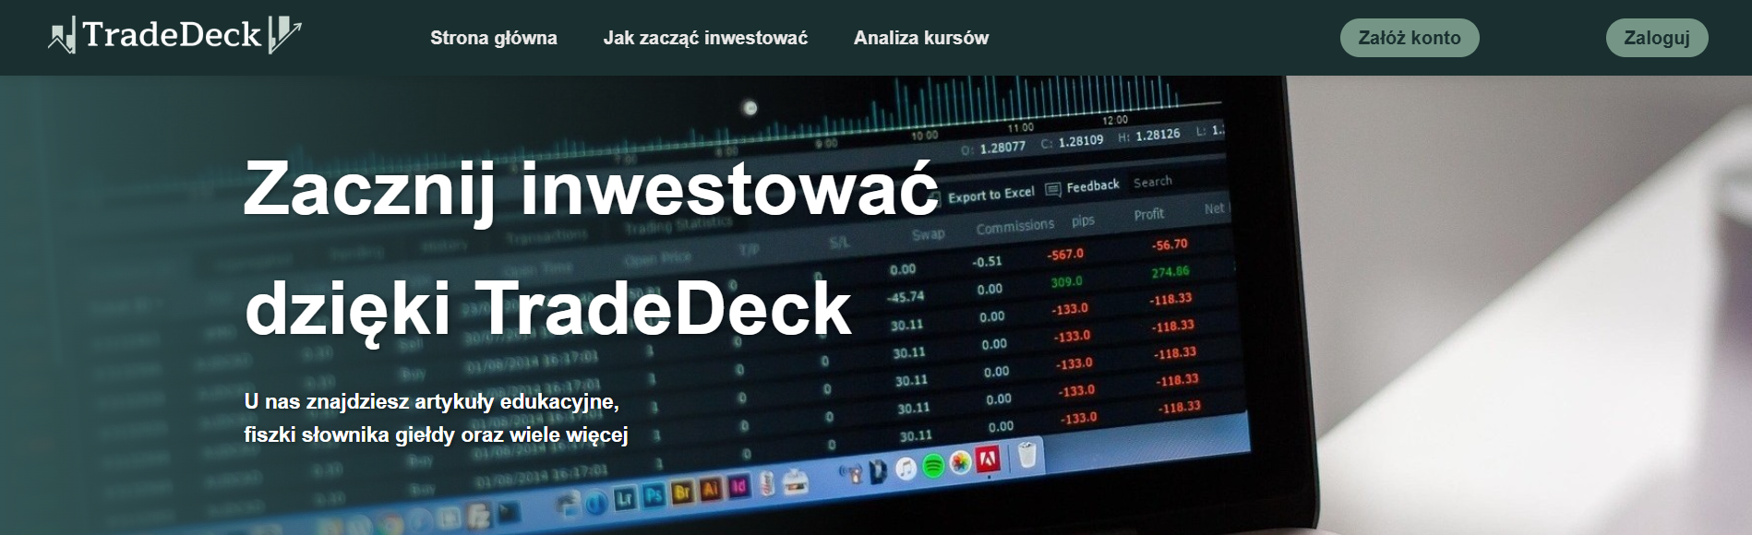
Header
Kamila

Slide 22
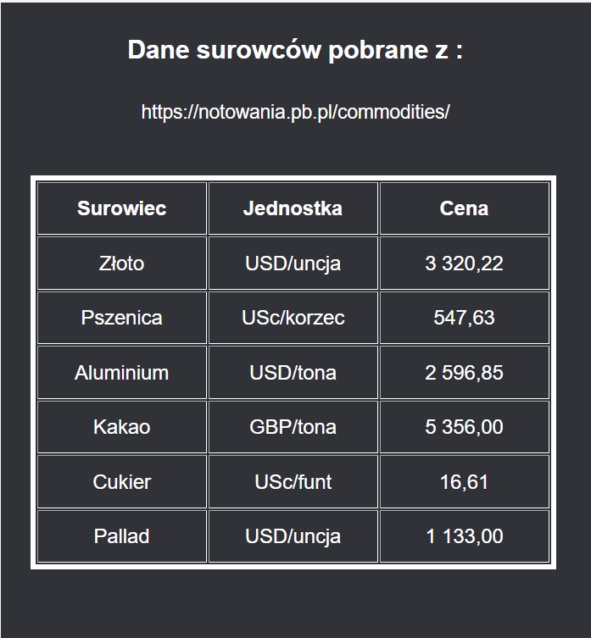
Adam
Patryk

Slide 23
Skrypty:
<?php
require 'config.php';
$url = "https://notowania.pb.pl/commodities/";
$dom = new DOMDocument();
@$dom->loadHTMLFile($url);
$xpath = new DOMXPath($dom);
$commodityXpaths = [
'złoto' => /*jedn*/ '//*[@id="quotes-commodities-quotes-table-box"]/div/div/div[2]/div/table/tbody/tr[14]/td[2]',
'pszenica' => /*jedn*/ '//*[@id="quotes-commodities-quotes-table-box"]/div/div/div[2]/div/table/tbody/tr[32]/td[2]',
'aluminium' => /*jedn*/ '//*[@id="quotes-commodities-quotes-table-box"]/div/div/div[2]/div/table/tbody/tr[1]/td[2]',
'kakao' => /*jedn*/ '//*[@id="quotes-commodities-quotes-table-box"]/div/div/div[2]/div/table/tbody/tr[5]/td[2]',
'cukier' => '//*[@id="quotes-commodities-quotes-table-box"]/div/div/div[2]/div/table/tbody/tr[31]/td[2]',
'pallad' => '//*[@id="quotes-commodities-quotes-table-box"]/div/div/div[2]/div/table/tbody/tr[20]/td[2]'
];
Kopiowanie ceny kursu 1/2
Patryk

Slide 24
Skrypty:
$stmt = $pdo->prepare("INSERT INTO historyczne_ceny (surowiec, jednostka, cena, data_pobrana) VALUES (:surowiec, :jednostka, :cena, :data_pobrana)");
foreach ($commodityXpaths as $commodity => $xPathCommodity) {
$commodityElements = $xpath->query($xPathCommodity);
$jednostka = ($commodityElements->length > 0) ? trim($commodityElements->item(0)->nodeValue) : 'Brak danych.';
$xPathRate = $rateXpaths[$commodity];
$rateElements = $xpath->query($xPathRate);
$cena = ($rateElements->length > 0) ? floatval(str_replace(',', '.', preg_replace('/[^\d.,]/', '', $rateElements->item(0)->nodeValue))) : null;
$data_pobrana = date('Y-m-d H:i:s');
if ($cena !== null) {
$stmt->execute([
':surowiec' => ucfirst($commodity),
':jednostka' => $jednostka,
':cena' => $cena,
':data_pobrana' => $data_pobrana
]);
}
}
?>
Kopiowanie ceny kursu
2/2
Patryk

Slide 25

Skrypt Wyświetlania kursu 1/2
Kody
Patryk

Slide 26
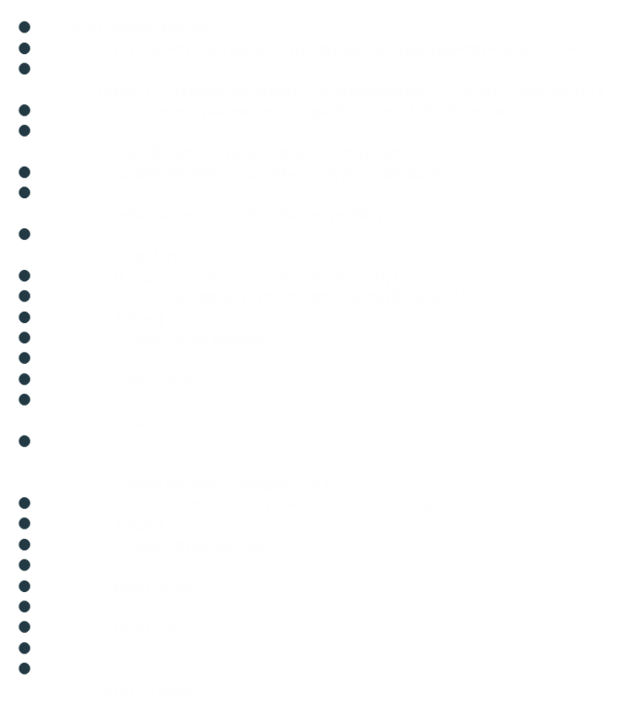
Skrypt Wyświetlania kursu 2/2
Kody
Patryk

Slide 27
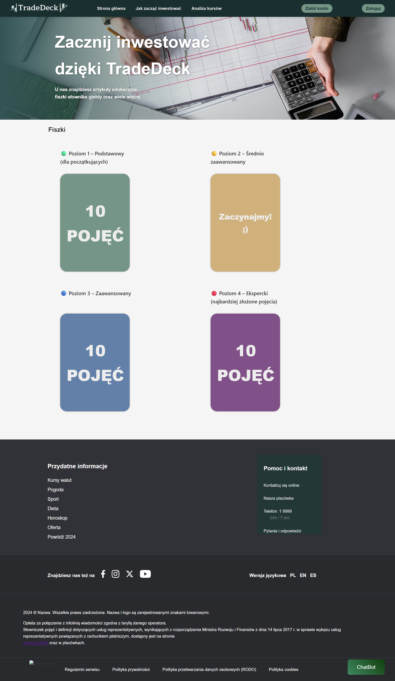
Podstrona do nauki tradingu - zawiera 4 zestawy fiszek z pojęciami giełdowymi
Patryk (backend) Kamila (frontend)

Slide 28
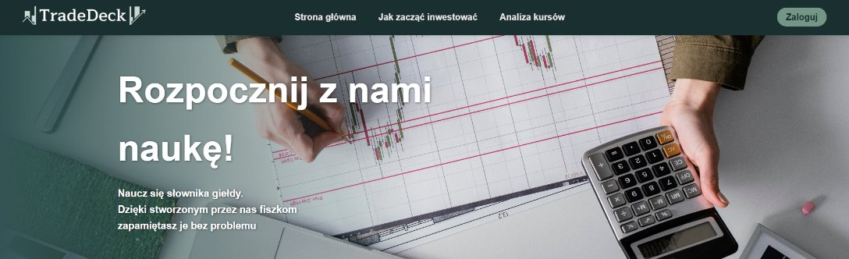
Header
Kamila

Slide 29
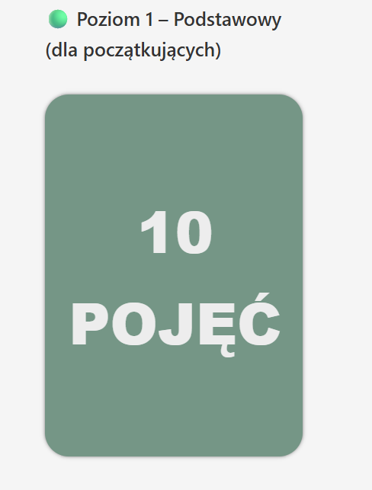
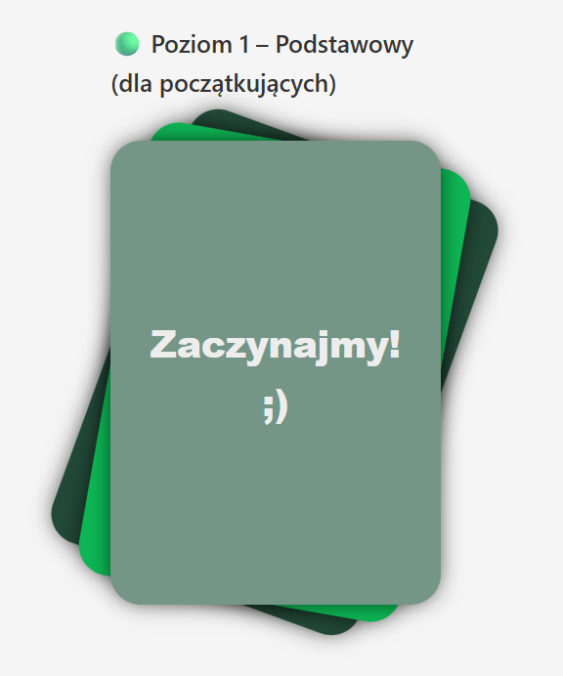
Podstrona z Fiszkami
Animacja po najechaniu na "karty"
Kamila (frontend)

Slide 30
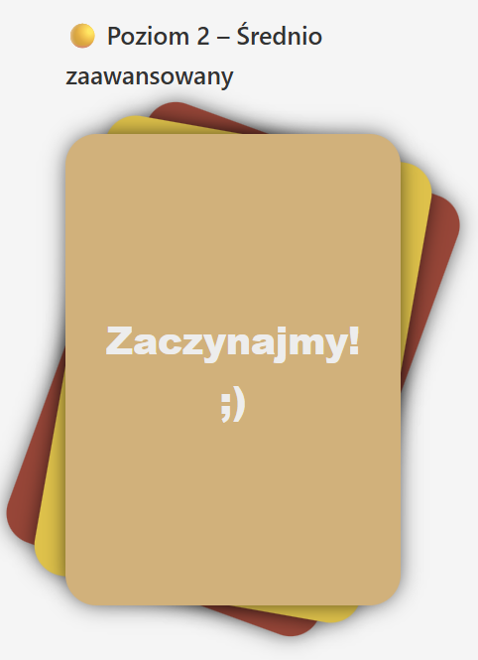
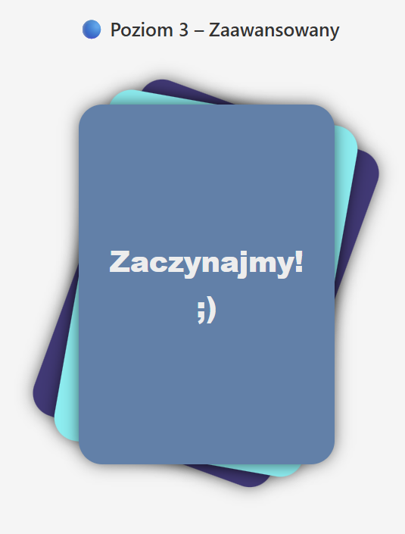
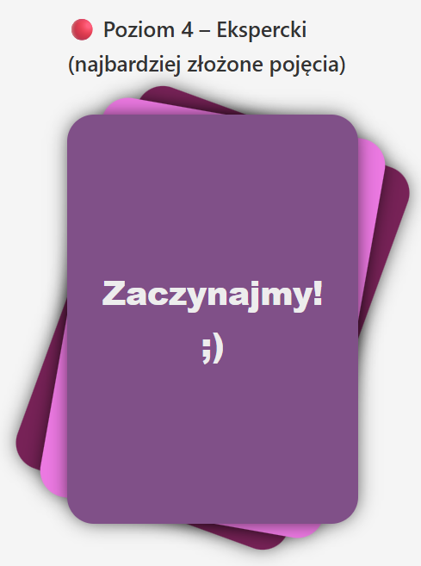

Podstrona z Fiszkami
Kamila (frontend)
Animacja każdej "karty"

Slide 31
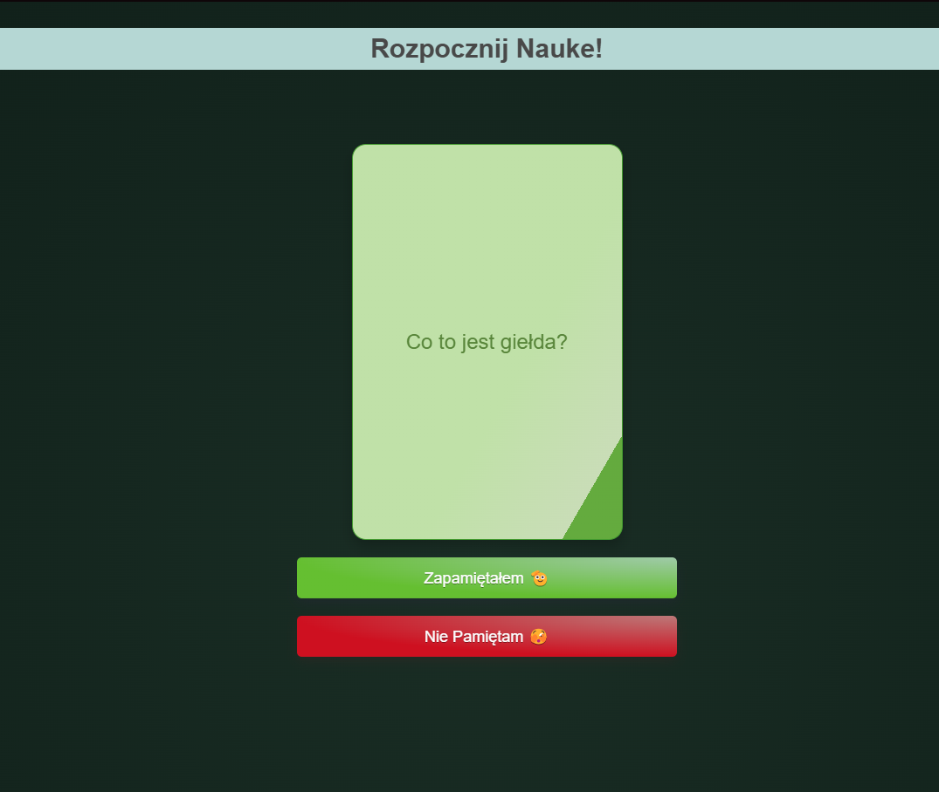
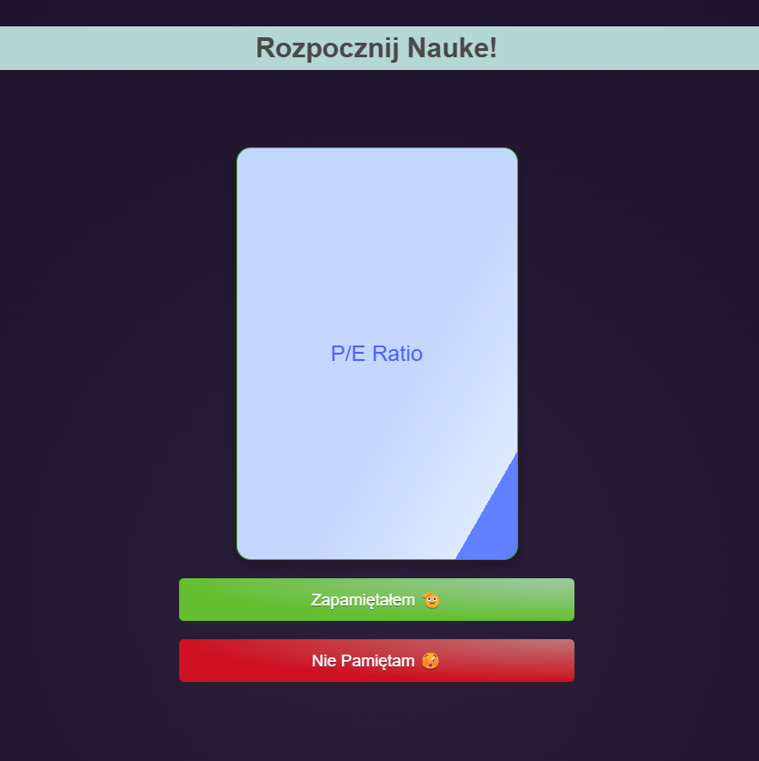
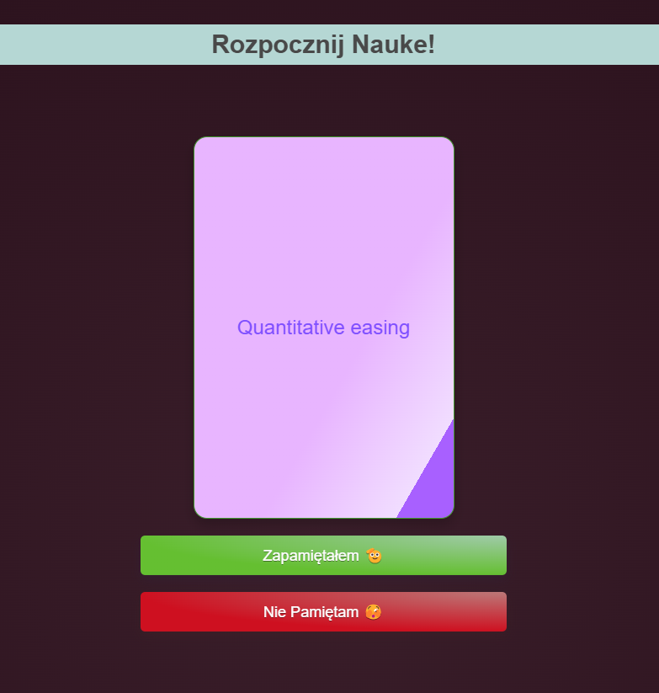
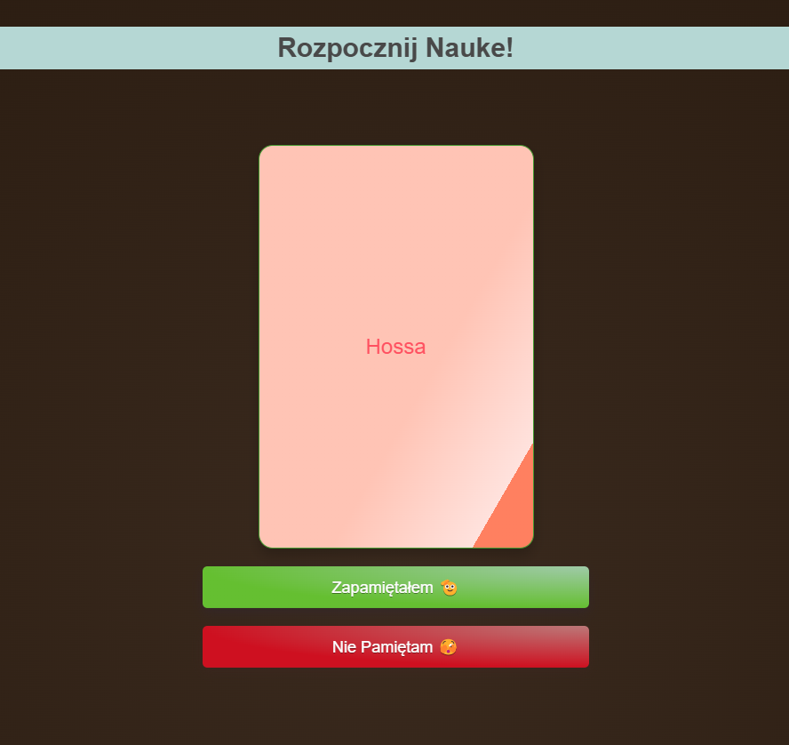
Fiszki
Patryk (backend) Kamila (frontend)

Slide 32
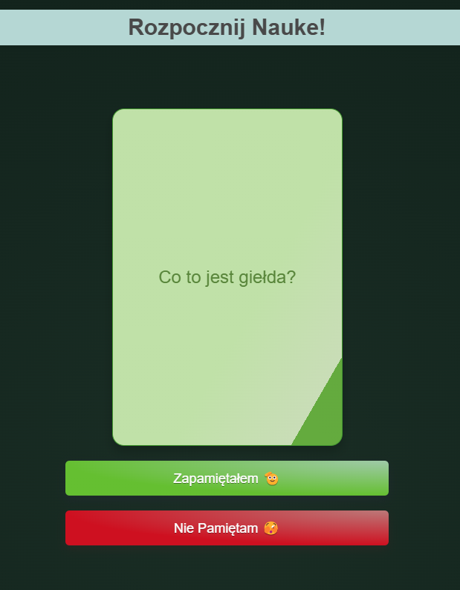
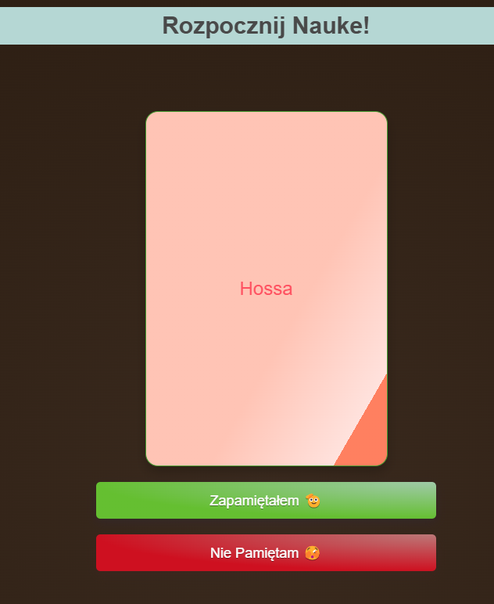
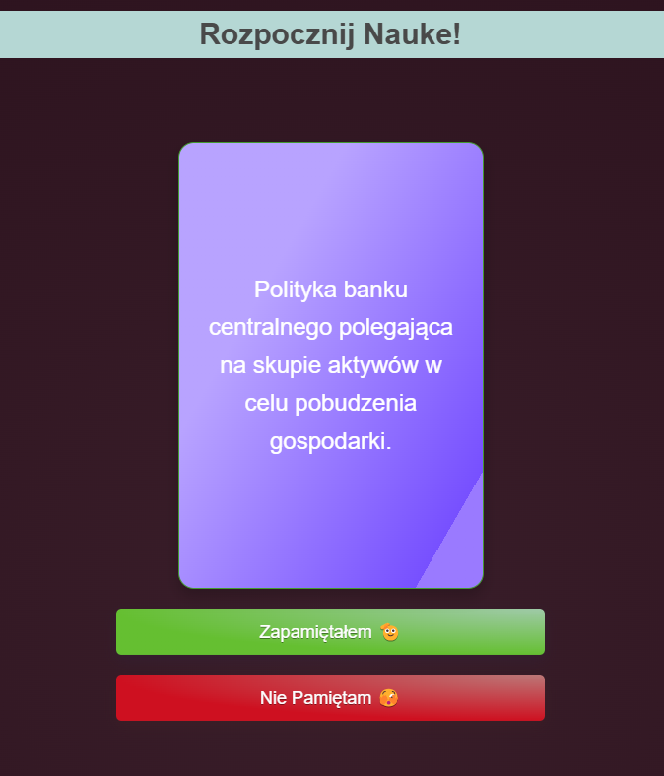
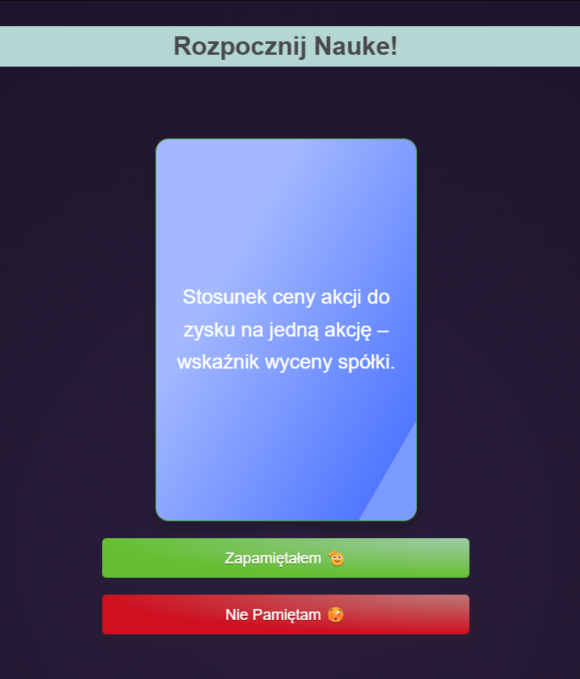
Fiszki
Patryk (backend) Kamila (frontend)

Slide 33
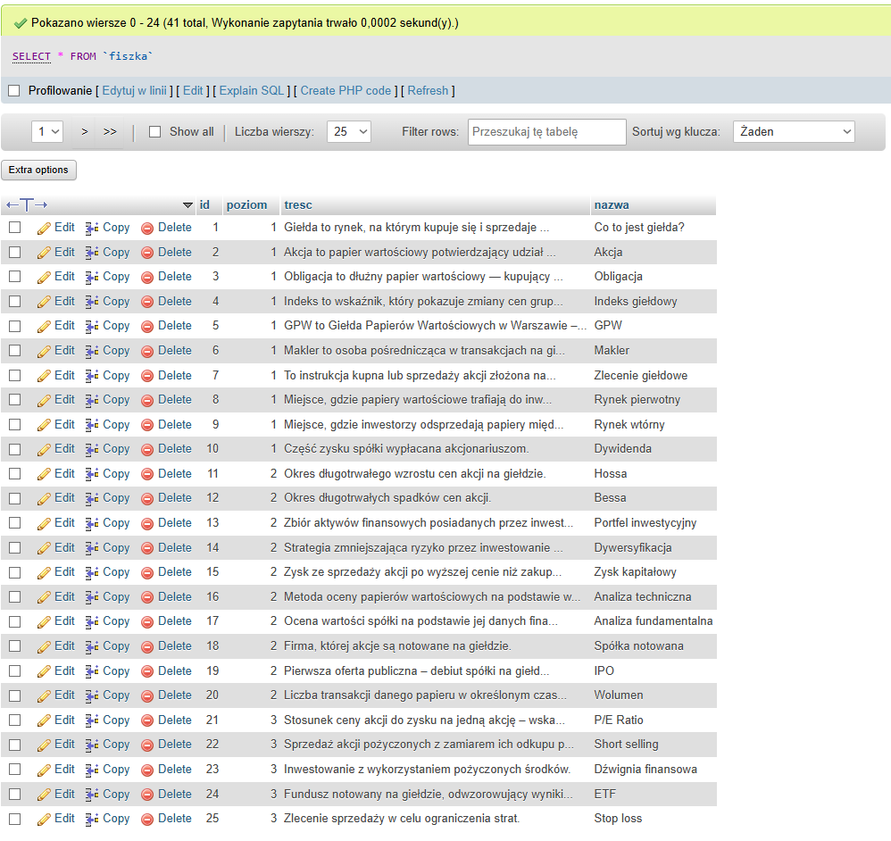
Baza danych - fiszka
Patryk

Slide 34
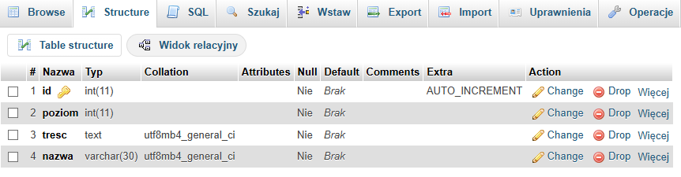
Baza danych - fiszka
Patryk

Slide 35
Skrypt fiszki 1/2
Kody
<script>
document.addEventListener("DOMContentLoaded", () => {
const cards = document.querySelectorAll(".sub-card");
cards.forEach(card => {
const title = card.querySelector(".card__title");
card.addEventListener("mouseenter", () => {
title.textContent = "Zaczynajmy! ;)";
title.classList.add("highlight-text");
});
card.addEventListener("mouseleave", () => {
title.textContent = "10 POJĘĆ";
title.classList.remove("highlight-text");
});
});
const modal = document.getElementById("myModal");
const closeBtn = modal.querySelector(".close");
const flipCard = document.querySelector('.flip-card');
function loadFiszki(level = 1) {
// USUŃ poprzednie klasy level-X
modal.classList.remove("level-1", "level-2", "level-3", "level-4");
flipCard.classList.remove("level-1", "level-2", "level-3", "level-4");
// DODAJ aktualną klasę level-X
modal.classList.add(`level-${level}`);
flipCard.classList.add(`level-${level}`);
Patryk

Slide 36
Skrypt fiszki 2/2
Kody
fetch(`get_fiszki.php?level=${level}`)
.then(response => response.json())
.then(data => {
if (data.length > 0) {
let index = 0;
let isFlipped = false;
const pojecie = document.getElementById("pojecie");
const definicja = document.getElementById("definicja");
const nextBtn = document.getElementById("nextBtn");
function showFront(i) {
pojecie.textContent = data[i].nazwa;
definicja.textContent = "";
flipCard.classList.remove('flipped');
isFlipped = false;
nextBtn.disabled = true;
}
function showBack(i) {
definicja.textContent = data[i].tresc;
flipCard.classList.add('flipped');
isFlipped = true;
nextBtn.disabled = false;
}
showFront(index);
flipCard.onclick = () => {
if (!isFlipped) {
showBack(index);
}
};
nextBtn.onclick = () => {
if (isFlipped) {
index = (index + 1) % data.length;
showFront(index);
}
};
}
});
}
Patryk

Slide 37
Stylizacja fiszki 1/2
Kody
.cards{
display: grid;
grid-template-columns: 1fr 1fr;
gap: 10px;
}
.sub-card{
margin-top: 5%;
margin-left: 8%;
font-family: -apple-system, BlinkMacSystemFont, "Segoe UI", Roboto, Oxygen,
Ubuntu, Cantarell, "Open Sans", "Helvetica Neue", sans-serif;
font-weight: 600;
font-size: 20px;
margin-top: 10%;
}
.card-beginer {
--main-color: rgb(237, 237, 237);
--sub-color: #224938;
--sub-sub-color: #0db654;
--bg-color: #759686;
--accent-color: #242c88;
position: relative;
font-family: -apple-system, BlinkMacSystemFont, "Segoe UI", Roboto, Oxygen,
Ubuntu, Cantarell, "Open Sans", "Helvetica Neue", sans-serif;
width: 270px;
height: 380px;
padding: 25px;
border-radius: 25px;
display: flex;
align-items: center;
gap: 5px;
background-color: var(--bg-color);
transition: all 0.2s;
cursor: pointer;
box-shadow: 0px 0px 5px -1.5px #000;
}
Kamila

Slide 38
Stylizacja fiszki 2/2
Kody
card__wrapper {
display: flex;
flex-direction: row;
justify-content: space-between;
align-items: center;
}
.card__title {
color: var(--main-color);
font-weight: 900;
font-size: 60px;
text-align: center;
}
.card-beginer:hover,
.card-intermediate:hover,
.card-advanced:hover,
.card-expert:hover {
box-shadow: 0px 0px 20px -5px #000;
}
.card-beginer:hover::before,
.card-intermediate:hover::before,
.card-advanced:hover::before,
.card-expert:hover::before {
transform: rotate(20deg);
box-shadow: 0px 0px 20px -5px #000;
}
.card__overlay {
content: "";
width: 99%;
height: 99%;
background: var(--sub-sub-color);
position: absolute;
z-index: -1;
top: 1px;
left: 1px;
border-radius: 25px;
transition: all 0.3s;
}
Kamila

Slide 39
Skrypt Konfigurujący Baze Danych
Kody
<?php
$host = 'localhost';
$db = 'fiszki';
$user = 'root';
$pass = '';
$charset = 'utf8mb4';
$pdo = new PDO("mysql:host=$host;dbname=$db;charset=$charset", $user, $pass);
$pdo->setAttribute(PDO::ATTR_ERRMODE, PDO::ERRMODE_EXCEPTION);
$level = isset($_GET['level']) ? (int)$_GET['level'] : 1;
$stmt = $pdo->prepare("SELECT nazwa, tresc FROM fiszka WHERE poziom = ? LIMIT 10");
$stmt->execute([$level]);
$fiszki = $stmt->fetchAll(PDO::FETCH_ASSOC);
echo json_encode($fiszki);
?>
Patryk

Slide 40
Skrypt Animacji Fiszek
Kody
document.addEventListener("DOMContentLoaded", () => {
const cards = document.querySelectorAll(".sub-card");
cards.forEach(card => {
const title = card.querySelector(".card__title");
card.addEventListener("mouseenter", () => {
title.textContent = "Zaczynajmy! ;)";
title.classList.add("highlight-text");
});
card.addEventListener("mouseleave", () => {
title.textContent = "10 POJĘĆ";
title.classList.remove("highlight-text");
});
});
Kamila

Slide 41
Skrypty:
<?php
ini_set('display_errors', 1);
ini_set('display_startup_errors', 1);
error_reporting(E_ALL);
require 'config.php';
$materials = ['złoto', 'pszenica', 'aluminium', 'kakao', 'cukier', 'pallad'];
$chosenMaterial = $_GET['surowiec'] ?? 'złoto';
$dateFrom = $_GET['data_od'] ?? date('Y-m-d', strtotime('-1 day'));
$dateTo = $_GET['data_do'] ?? date('Y-m-d');
$stmt = $pdo->prepare("
SELECT surowiec, jednostka, cena, data_pobrana
FROM historyczne_ceny
WHERE surowiec = :surowiec
AND data_pobrana BETWEEN :data_od AND :data_do
ORDER BY data_pobrana ASC
");
$stmt->execute([
':surowiec' => ucfirst($chosenMaterial),
':data_od' => $dateFrom . ' 00:00:00',
':data_do' => $dateTo . ' 23:59:59'
]);
$data = $stmt->fetchAll();
Tworzenie wykresu 1/2
Patryk

Slide 42
Skrypty:
echo '<canvas id="chart_' . htmlspecialchars($chosenMaterial) . '" width="1000" height="500"></canvas>';
echo '<script src="https://cdn.jsdelivr.net/npm/chart.js"></script>';
echo '<script>
const ctx_' . htmlspecialchars($chosenMaterial) . ' = document.getElementById("chart_' . htmlspecialchars($chosenMaterial) . '").getContext("2d");
new Chart(ctx_' . htmlspecialchars($chosenMaterial) . ', {
type: "line",
data: {
labels: ' . json_encode($labels) . ',
datasets: [{
label: "Cena (' . htmlspecialchars($jednostka) . ')",
data: ' . json_encode($prices) . ',
borderColor: "rgba(75, 192, 192, 1)",
backgroundColor: "rgba(75, 192, 192, 0.2)",
fill: true,
tension: 0.1
}]
},
options: {
scales: {
x: {
display: true,
title: {
display: true,
text: "Data i Godzina"
}
},
y: {
display: true,
title: {
display: true,
text: "Cena (' . htmlspecialchars($jednostka) . ')"
Tworzenie wykresu 2/2
Patryk

Slide 43
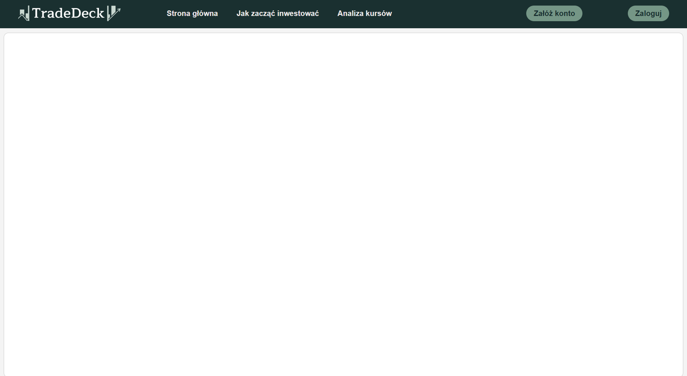
Podstrona do rozmowy z asystentem AI
Adam (backend oraz frontend)

Slide 44
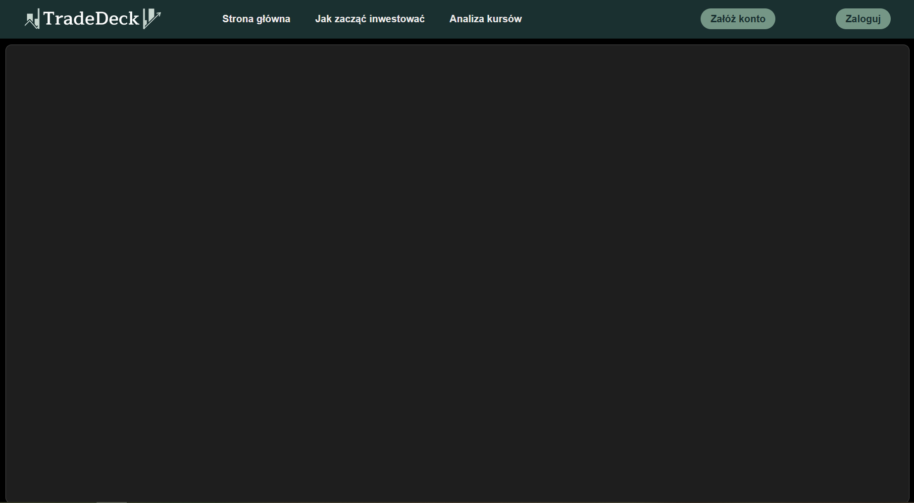
Podstrona do rozmowy z asystentem AI (wersja ciemna)
Adam (backend oraz frontend)

Slide 45
Skrypty:
from flask import Flask, request, jsonify
import ollama
from flask_cors import CORS
app = Flask(__name__)
CORS(app)
model = 'SpeakLeash/bielik-11b-v2.3-instruct:Q6_K'
personality = (
"Masz na imię Sebastian, "
"jesteś przyjaznym i inteligentnym asystentem giełdowym. "
"Odpowiadaj tylko na zapytania związane z giełdą. "
"Nie znasz się na niczym innym niż giełda. "
"Bądź miły i radosny. "
"Odpowiadaj tak krótko jak to możliwe ale w sposób zrozumiały, miły i życzliwy. "
)
history = [
{'role': 'system', 'content': personality}
]
Chatbot 1/2
Adam

Slide 46
Skrypty:
@app.route('/chat', methods=['POST'])
def chat():
try:
data = request.json
user_input = data.get('message', '')
if not user_input:
return jsonify({'error': 'No message provided'}), 400
history.append({'role': 'user', 'content': user_input})
response = ollama.chat(
model=model,
messages=history
)
reply = response['message']['content']
history.append({'role': 'assistant', 'content': reply})
return jsonify({'reply': reply})
except Exception as e:
print("Błąd po stronie serwera:", str(e))
return jsonify({'error': 'Server error', 'details': str(e)}), 500
if __name__ == '__main__':
app.run(debug=True)
Chatbot 2/2
Adam

Slide 47
Skrypty:
const chatHistory = document.getElementById("history");
const userInput = document.getElementById("input2");
function sendMessage() {
const text = userInput.value.trim();
if (text === "") return;
appendMessage("user", text);
userInput.value = "";
fetch("http://127.0.0.1:5000/chat", {
method: "POST",
headers: {
"Content-Type": "application/json"
},
body: JSON.stringify({message: text})
})
.then(response => {
if (!response.ok) {
throw new Error("Błąd odpowiedzi serwera");
}
return response.json();
})
.then(data => {
if (data.reply) {
appendMessage("bot", data.reply);
} else {
appendMessage("bot", "Brak odpowiedzi od serwera");
}
})
.catch(err => {
appendMessage("bot", "Błąd połączenia z serwerem.");
console.error("Błąd fetch:", err);
});
}
Obsługa rozmowy 1/2
Adam

Slide 48
Skrypty:
function appendMessage(sender, text) {
const msg = document.createElement("div");
msg.classList.add("message", sender);
msg.textContent = text;
chatHistory.appendChild(msg);
chatHistory.scrollTop = chatHistory.scrollHeight;
}
userInput.addEventListener("keypress", function (e) {
if (e.key === "Enter") {
sendMessage();
}
});
Obsługa rozmowy 2/2
Adam

Slide 49
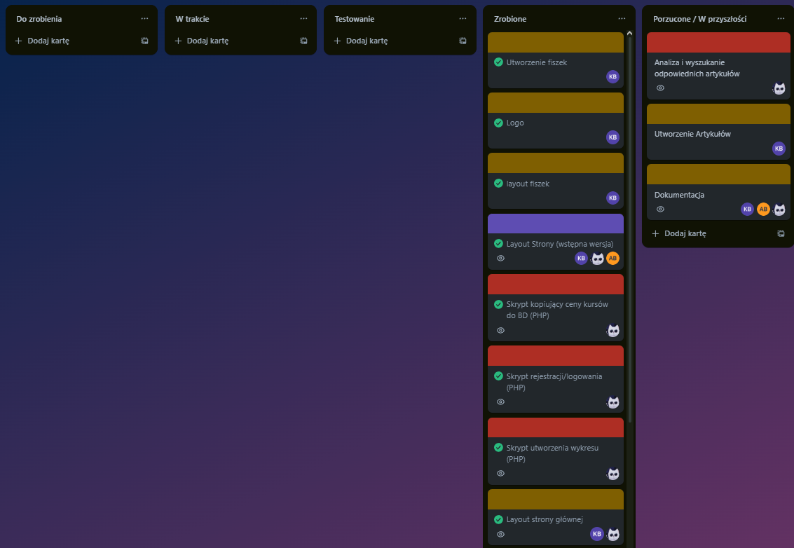
Stan tablicy Trello:

Slide 50
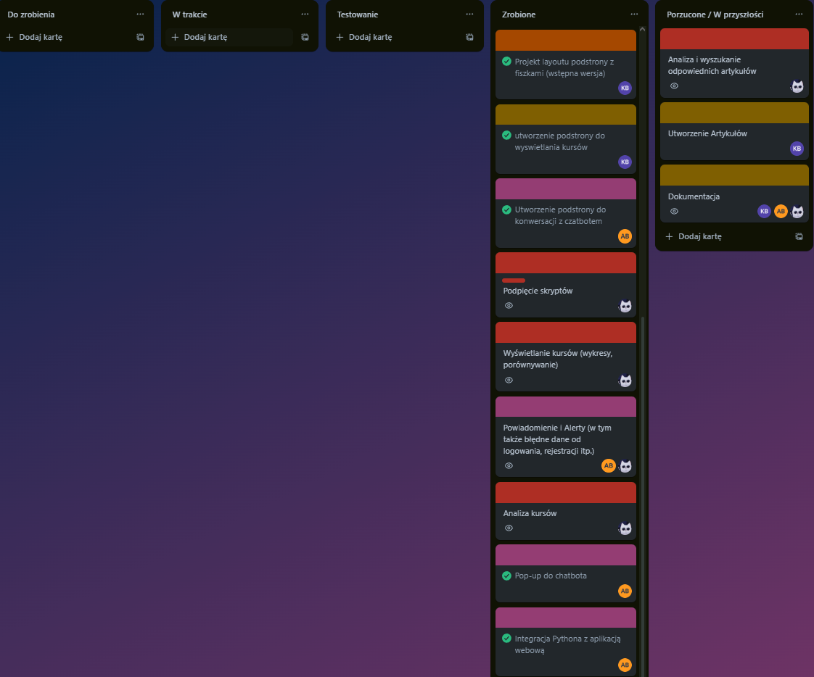
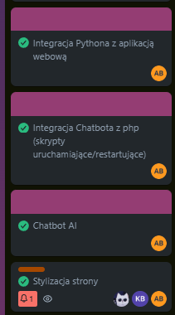
Stan tablicy Trello:

